Slide 1
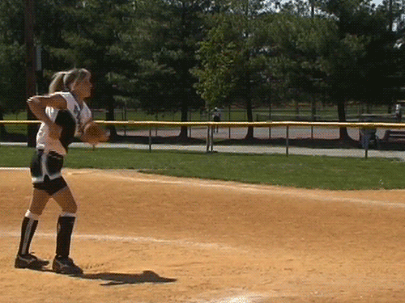
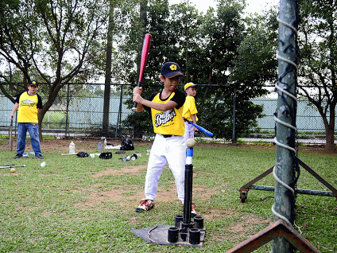
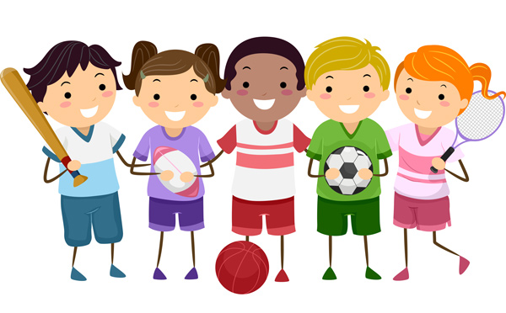
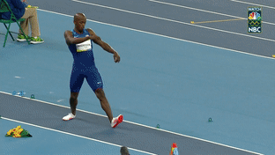
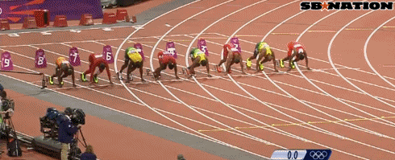
softball throw壘球擲遠
Tee Ball樂樂棒
100 meters race百米賽跑
long jump跳遠

Slide 2
messy and neat

Slide 3
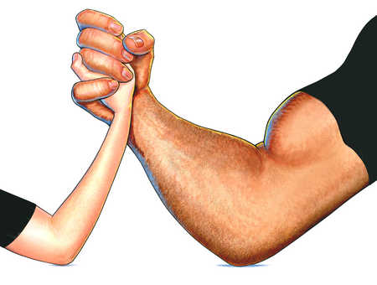
weak and strong

Slide 4
young and old

Slide 5
shy and outgoing

Slide 6
noisy and quiet

Slide 7
heavy and thin

Slide 8
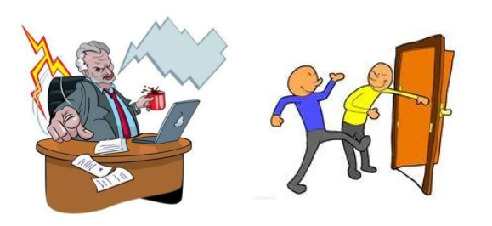
rude and polite

Slide 9
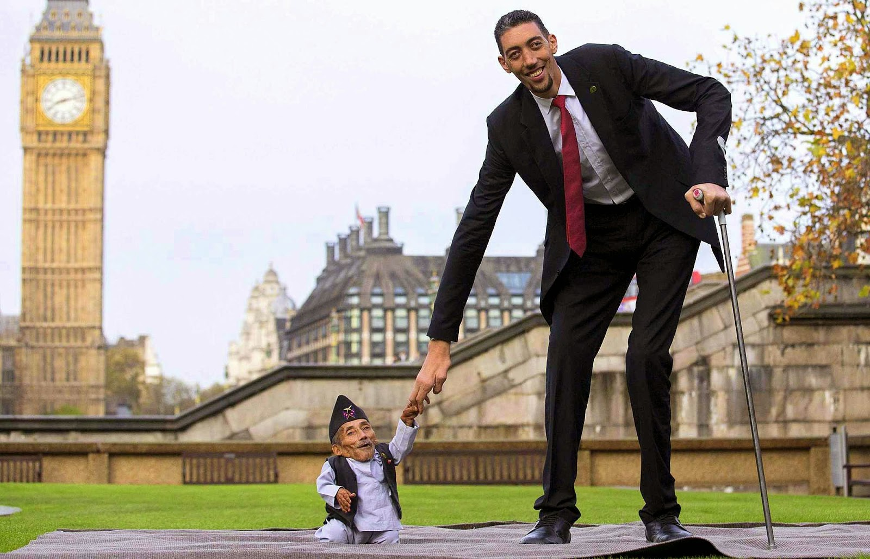
short and tall

Slide 10
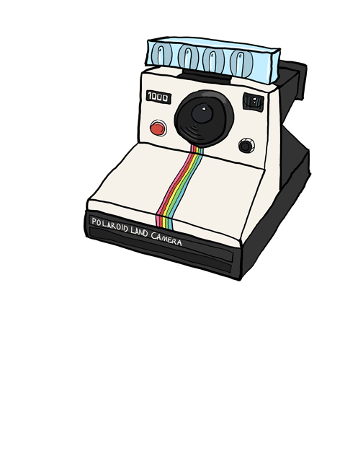
Paparazzi Time

Slide 11
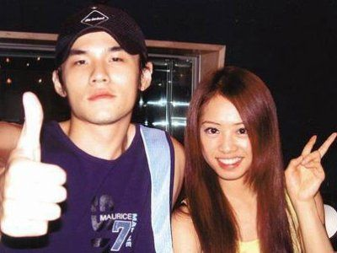
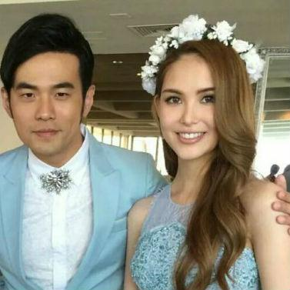
Jolin Tsai was Jay Chou’s girlfriend before, but Hannah is Jay Chou’s wife now.

Slide 12
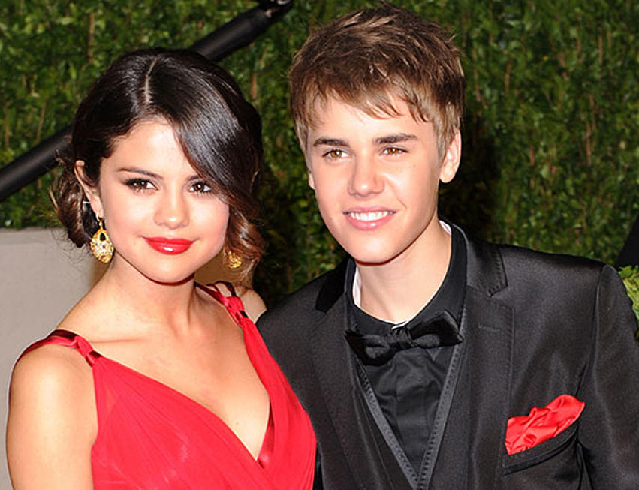
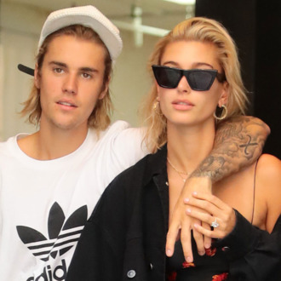
Selena Gomez was Justin Bieber’s girlfriend before, but Hailey Baldwin is Justin’s fiancée now.

Slide 13
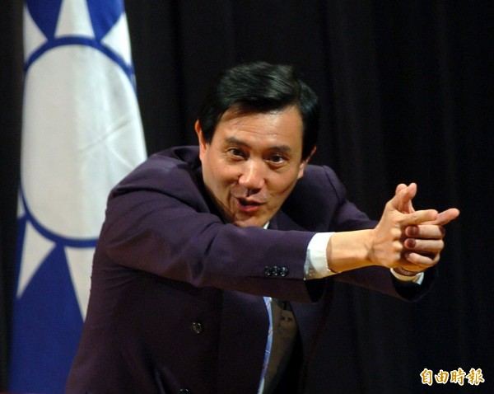
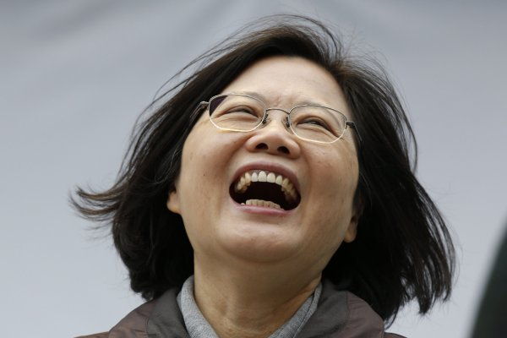
Ying-Chiu Ma was Taiwan’s president before, but Ing-wen Tsai is Taiwan’s president now.

Slide 14
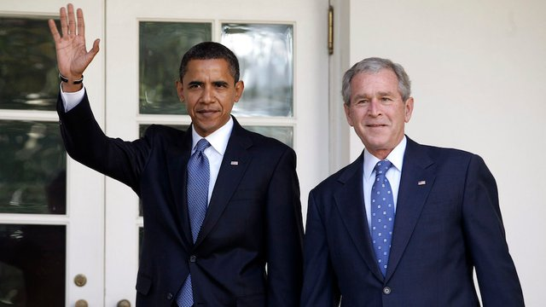
George W. Bush and Barack Obama were the presidents of America before, but Donald Trump is the leader of America now.

Slide 15
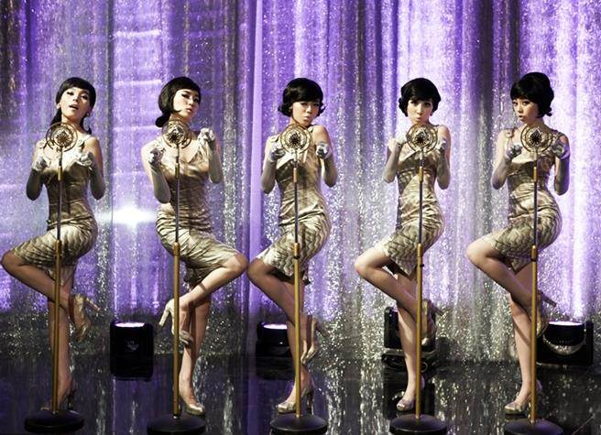
The members of Wonder Girl were so popular before, but the members of Twice are more popular now.

Slide 16
Song Hye-kyo was a famous Korean actress before, and she is still a super star now.

Slide 17
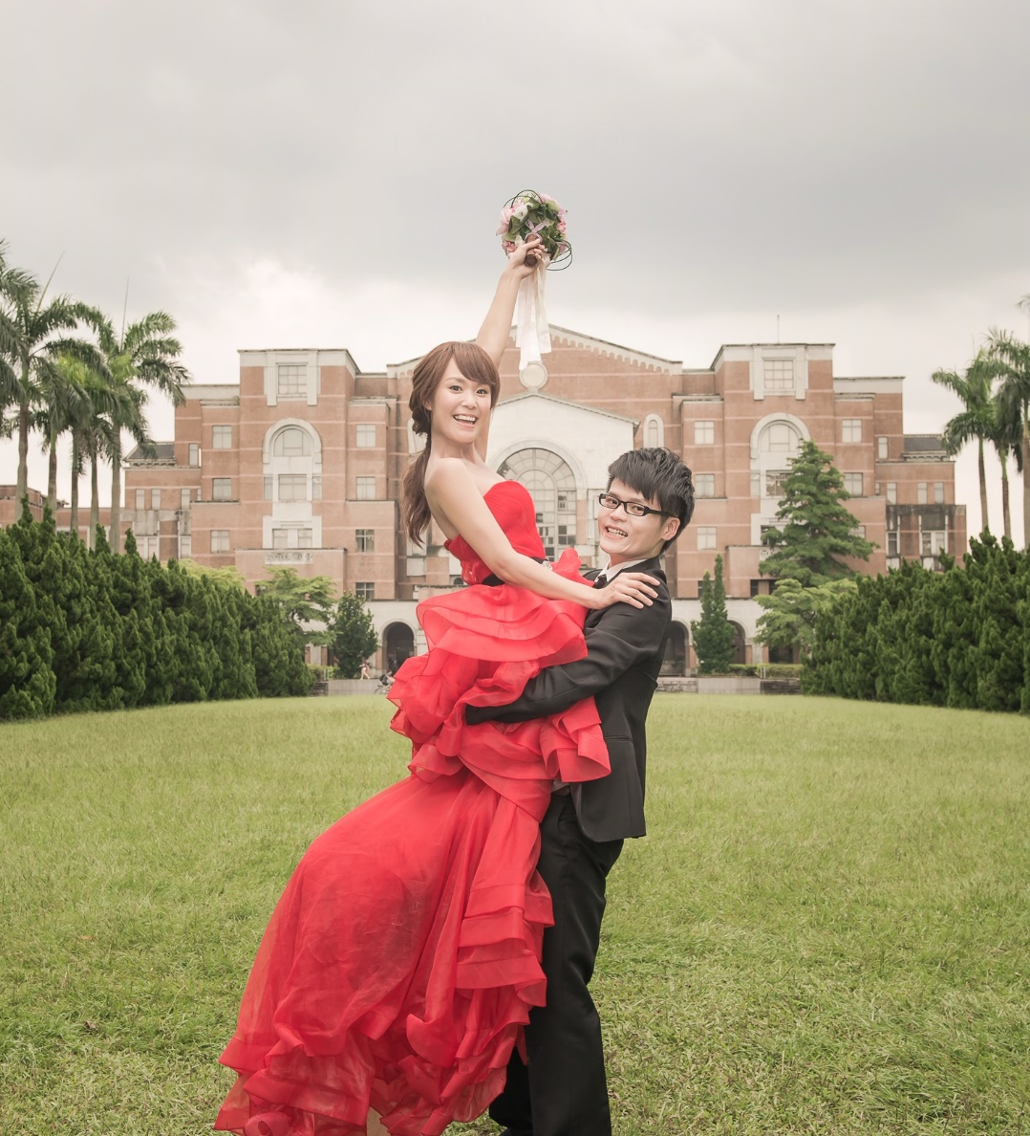
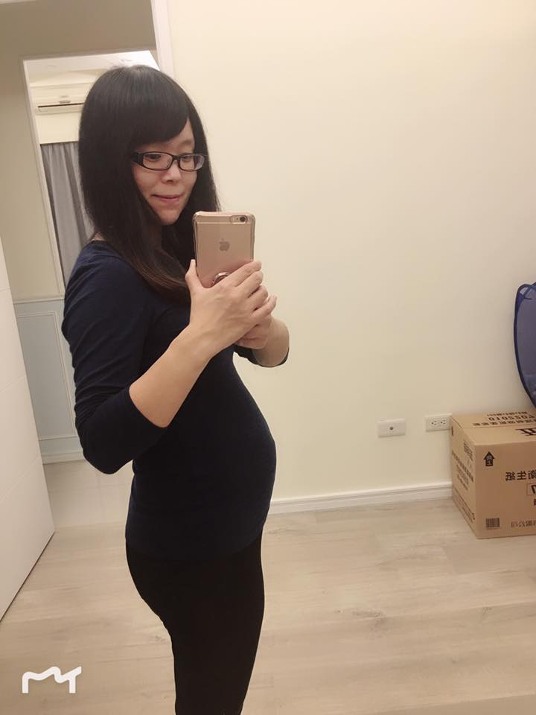
Mandy was thin before, but she is getting heavier now.

Slide 18
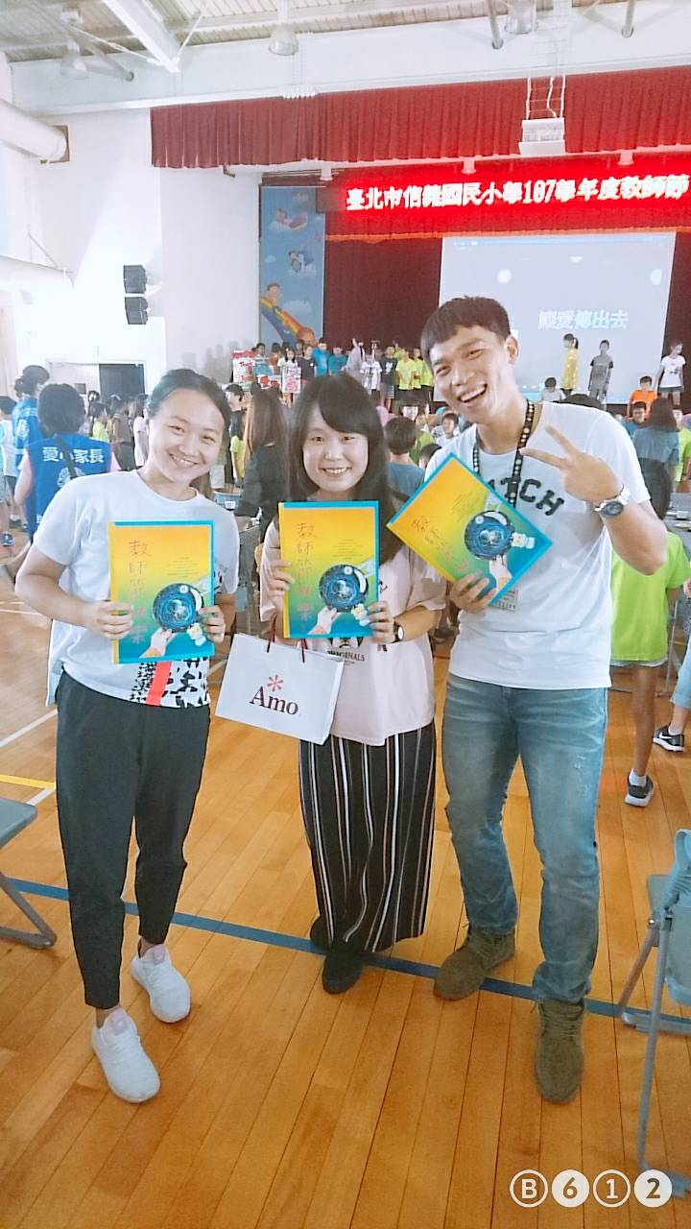
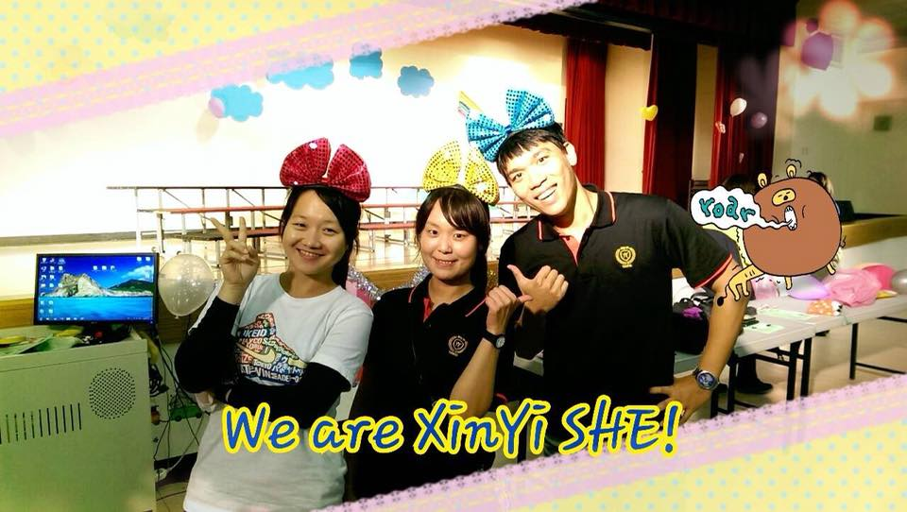
Kimi, Mandy and Bruce were good friends before, and they are still good friends now.

Slide 20
hot / cold
up / down
yes / no
wrong / right
in / out
black / white
fight = break up
kiss = make up

